Slide 1

CPU PERFORMANCE ISSUES
Lecturer: Jay A. Abaleta

Slide 2
Designing for Performance
Year by year, the cost of computer systems continues to drop dramatically, while the performance and capacity of those systems continue to rise equally dramatically. Today’s laptops have the computing power of an IBM mainframe from 10 or 15 years ago. Thus, we have virtually “free” computer power.
Processors are so inexpensive that we now have microprocessors we throw away.
The digital pregnancy test is an example (used once and then thrown away). And this continuing technological revolution has enabled the development of applications of astounding complexity and power.

Slide 3

Example:
Desktop applications that require the great power of today’s microprocessor-based systems include:
Image processing
Three-dimensional rendering
Speech recognition
Videoconferencing
Multimedia authoring
Voice and video annotation of files
Simulation modeling

Slide 4
Key Considerations:
Clock Speed: Higher clock speeds allow more instructions to be executed per second.
Instruction Set Architecture (ISA): The design of the instruction set can impact performance. RISC (Reduced Instruction Set Computer) and CISC (Complex Instruction Set Computer) are two major architectures.
Pipelining: Allows overlapping of instruction execution stages to increase throughput.
Cache Hierarchy: Multi-level caching (L1, L2, L3) minimizes delays caused by memory access.
Parallelism:
Instruction-Level Parallelism (ILP): Executing multiple instructions at the same time.
Thread-Level Parallelism (TLP): Running multiple threads concurrently using multicore processors.
Power Efficiency: Balancing performance with energy consumption, especially for portable devices.

Slide 5
Two Laws that Provide Insight
Amdahl's Law
Little’s Law

Slide 6
The Amdahl’s law
What is Amdahl's Law?
Amdahl's Law is a principle in computer architecture that describes the potential speedup of a program when a particular portion of it is parallelized.
This Law was proposed by Gene Amdahl in 1967.
It is named after computer scientist Gene Amdahl( a computer architect from IBM and Amdahl corporation) and was presented at the AFIPS Spring Joint Computer Conference in 1967.
It is also known as Amdahl’s argument.

Slide 7
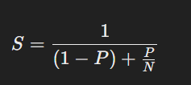
Amdahl's Law Formula
​Where:
S = Overall system speedup
P = Proportion of the system that can be improved
N = Speedup factor for the improved portion

Slide 8
Example:
Problem Set:
A task takes 100 seconds to complete,
where:
70% (P = 0.7) of the task can be optimized (parallelizable).
The speedup factor for the optimized portion is 5 (N = 5)
(it runs 5x faster after optimization).

Slide 9

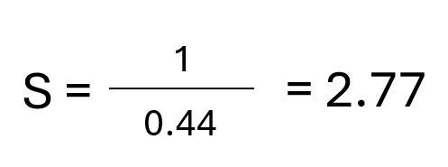

Solution:
Substitute P=0.7 and N=5 into the formula:
Calculate the Non-Parallelizable Portion:
(1−0.7) = 0.3 0.7/5​ = 0.14
Combine Both Portions:
0.3 + 0.14 = 0.44
Calculate the Speedup (S):
The overall speedup system is 2.27x faster.

Slide 10
Advantages of Amdahl’s law
Provides a way to quantify the maximum potential speedup that can be achieved by parallelizing a program, which can help guide decisions about hardware and software design.
Helps to identify the portions of a program that are not easily parallelizable, which can guide efforts to optimize those portions of the code.
Provides a framework for understanding the trade-offs between parallelization and other forms of optimization, such as code optimization and algorithmic improvements.

Slide 11
Disadvantages of Amdahl’s law
Assumes that the portion of the program that cannot be parallelized is fixed, which may not be the case in practice.
Assumes that all processors have the same performance characteristics, which may not be the case in practice.
Does not take account the other factors that can affect the performance of parallel programs, such as communication overhead and load balancing.
Notes:
For example, it is possible to optimize code to reduce the portion of the program that cannot be parallelized, making Amdahl’s law less accurate.
For example, in a heterogeneous computing environment, some processors may be faster than others, which can affect the potential speedup that can be achieved.

Slide 12

The Little’s Law
Little’s Law is a mathematical equation that establishes a relationship between three key parameters in a queuing system.
To establish a relationship between system performance metrics in queuing systems like CPUs or networks.

Slide 13
The Formula
L=λ⋅W
Where:
L = Average number of items in the system (e.g., instructions in a queue)
λ (lambda) = Arrival rate of items to the system (e.g., instruction arrival rate)
W = Average waiting time for an item in the system

Slide 14
Example:
Scenario:
A coffee shop serves an average of 10 customers per hour (arrival rate λ=10). The average time each customer spends in the shop, from entering to leaving, is 0.5 hours (W = 0.5).
Goal: Determine the average number of customers in the coffee shop (L).

Slide 15

Solution
Apply Little’s Law Formula:
1
L=λ⋅W
Substitute the Given Values:
2
L=10 ⋅ 0.5
Calculate L:
3
L=5

Slide 16
Basic Measures of Performance
Improving the performance of a computer system typically involves optimizing one or more of these factors to reduce the time and resources required to complete tasks.
This can involve upgrading hardware components, optimizing software, and using specialized performance-tuning tools to identify and address bottlenecks in the system.

Slide 17
What are the Key Metrics:
1. Clock Rate (GHz):
Measures the speed of the CPU in terms of clock cycles per second.
A higher clock rate often translates to faster performance, but it depends on the workload.
2. Instructions Per Cycle (IPC):
Indicates how many instructions a CPU can execute per clock cycle.
Influenced by architecture optimizations like pipelining and parallelism.
3. Throughput:
The number of tasks a CPU can complete in a given amount of time.
Crucial for server workloads.

Slide 18
What are the Key Metrics:
4. Latency:
The time taken to execute a single task or instruction.
Important for real-time applications.
5. CPI (Cycles Per Instruction):
Average number of clock cycles needed to execute one instruction.
Lower CPI indicates better performance.

Slide 19
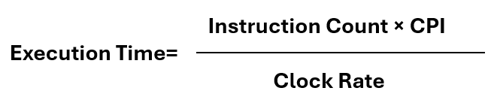
The Performance Calculation
The Formula:
Where:
Instruction Count: Total number of instructions executed by the program.
CPI: Average cycles per instruction.
Clock Rate: Number of clock cycles per second.

